Slide 1

DataSet Transformations with Apache Flink
Timo Walther Flink Committer, PMC Member
twalthr@apache.org

Slide 2
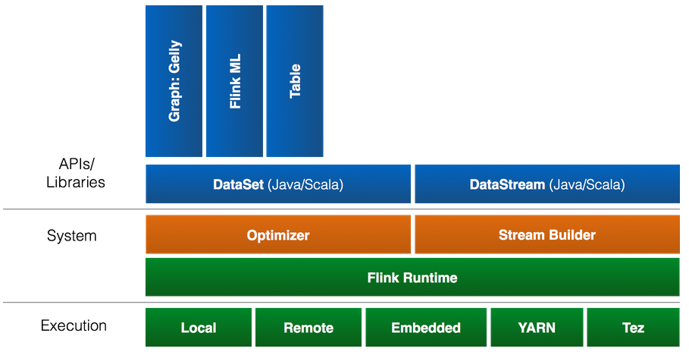
Overview / Flink Stack

Slide 3
All starts with an Environment
public class ExampleProgram {
public static void main(String[] args) throws Exception {
final ExecutionEnvironment env = ExecutionEnvironment.getExecutionEnvironment();
DataSet<String> text = env.fromElements("Hello", "World");
DataSet<String> moreText = env.readFromCsv("/path/to/file");
DataSet<String> evenMoreText = env.readHadoopFile("/path/to/file");
// add operators to your plan
// List<Tuple2<String, Integer>> list = text.collect();
// text.print();
env.execute();
}
}

Slide 4
Important Operators: .map()
// Takes one element and produces one element.
DataSet<Integer> tokenized = text.map(new MapFunction<String, Integer>() {
@Override
public Integer map(String value) {
return Integer.parseInt(value);
}
}); DataSet<ExperimentResult> converted = text.map( new MapFunction<String, ExperimentResult>() { ... });
static class ExperimentResult {
public String name;
public Tuple2<String, Long>[] parameters;
public int result;
}

Slide 5
.flatMap(), .filter(),
// Takes one element and produces zero, one, or more elements.
data.flatMap(new FlatMapFunction<String, String>() {
public void flatMap(String value, Collector<String> out) {
for (String s : value.split(" ")) {
out.collect(s);
}
}
});
// Retains those elements for which the function returns true.
data.filter(new FilterFunction<Integer>() {
public boolean filter(Integer value) { return value > 1000; }
});

Slide 6
.join()
DataSet<ExperimentResult> input1= ...
DataSet<ExperimentResult> input2= ...
// Joins two data sets by creating all pairs of elements that are equal on
// their keys.
DataSet<Tuple2<ExperimentResult, ExperimentResult>> =
input1.join(input2)
.where("name") // key of the first input
.equalTo("name"); // key of the second input
DataSet<ExperimentResult> =
input1.join(input2)
.where("name") // key of the first input
.equalTo("name") // key of the second input
.with(...);

Slide 7
.reduce(), .reduceGroup()
// Combines a group of elements into a single element.
number.reduce(new ReduceFunction<Integer> {
public Integer reduce(Integer a, Integer b) { return a + b; }
});
// Combines a group of elements into one or more elements.
data
.groupBy("name")
.reduceGroup(new GroupReduceFunction<Integer, Integer> {
public void reduce(Iterable<Integer> values, Collector<Integer> out) {
int sum = 0;
for (Integer i : values) sum++;
out.collect(sum);
}
});

Slide 8
.min(), .max(), .sum(), .first()
DataSet<Tuple2<String, Integer>> data = ...
// Perform aggregation on fields.
data = data.sum(1);
data = data.min(1);
data = data.max(1);
// Returns the first n elements of a data set.
DataSet<Tuple2<String,Integer>> result = in.groupBy(0)
.sortGroup(1, Order.ASCENDING)
.first(3);

Slide 9
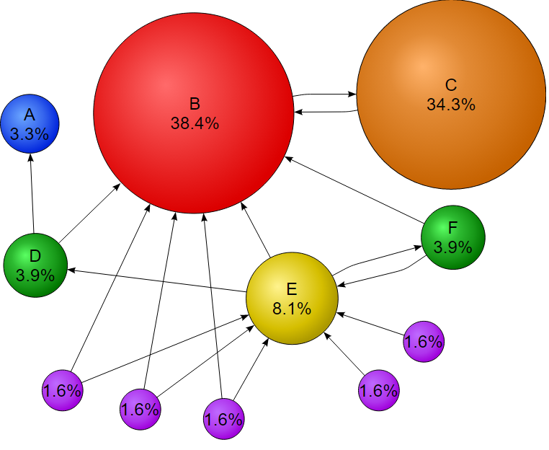
Advanced Example: Page Rank
Used for measuring the importance of website pages
More important websites are likely to receive more links from other websites

Slide 10
Advanced Example: Page Rank
// get input data
DataSet<Long> pagesInput = getPagesDataSet(env);
DataSet<Tuple2<Long, Long>> linksInput = getLinksDataSet(env);
// assign initial rank to pages
DataSet<Tuple2<Long, Double>> pagesWithRanks = pagesInput.
map(new RankAssigner((1.0d / numPages)));
// build adjacency list from link input
DataSet<Tuple2<Long, Long[]>> adjacencyListInput =
linksInput.groupBy(0).reduceGroup(new BuildOutgoingEdgeList());

Slide 11
Advanced Example: Page Rank
class BuildOutgoingEdgeList implements GroupReduceFunction<...>> {
@Override
public void reduce(Iterable<Tuple2<Long, Long>> values,
Collector<Tuple2<Long, Long[]>> out) {
ArrayList<Long> neighbors = new ArrayList<Long>();
Long id = 0L;
for (Tuple2<Long, Long> n : values) {
id = n.f0;
neighbors.add(n.f1);
}
out.collect(new Tuple2<>(id, neighbors.toArray()));
}
}

Slide 12
Advanced Example: Page Rank
// set iterative data set
IterativeDataSet<Tuple2<Long, Double>> iteration =
pagesWithRanks.iterate(maxIterations);
DataSet<Tuple2<Long, Double>> newRanks = iteration
// join pages with outgoing edges and distribute rank
.join(adjacencyListInput).where(0).equalTo(0)
.flatMap(new JoinVertexWithEdgesMatch())
// collect and sum ranks
.groupBy(0).sum(1)
// apply dampening factor // (value.f1 = (value.f1 * dampening) + randomJump)
.map(new Dampener(DAMPENING_FACTOR, numPages));

Slide 13
Advanced Example: Page Rank
// Distributes a fraction of a vertex's rank to all neighbors. class JoinVertexWithEdgesMatch implements FlatMapFunction<...>> {
@Override
public void flatMap(Tuple2<Tuple2<Long, Double>,
Tuple2<Long, Long[]>> value,
Collector<Tuple2<Long, Double>> out){
Long[] neigbors = value.f1.f1;
double rank = value.f0.f1;
double rankToDistribute = rank / ((double) neigbors.length);
for (int i = 0; i < neigbors.length; i++)
out.collect(new Tuple2<>(neigbors[i], rankToDistribute));
}
}

Slide 14
Advanced Example: Page Rank
// set iterative data set
IterativeDataSet<Tuple2<Long, Double>> iteration =
pagesWithRanks.iterate(maxIterations);
DataSet<Tuple2<Long, Double>> newRanks = iteration
// join pages with outgoing edges and distribute rank
.join(adjacencyListInput).where(0).equalTo(0)
.flatMap(new JoinVertexWithEdgesMatch())
// collect and sum ranks
.groupBy(0).sum(1)
// apply dampening factor // (value.f1 = (value.f1 * dampening) + randomJump)
.map(new Dampener(DAMPENING_FACTOR, numPages));

Slide 15
Advanced Example: Page Rank
// define next iteration and termination
DataSet<Tuple2<Long, Double>> finalPageRanks = iteration.closeWith(
newRanks,
newRanks.join(iteration).where(0).equalTo(0)
// termination condition
// Math.abs(value.f0.f1 - value.f1.f1) > EPSILON
.filter(new EpsilonFilter()));
finalPageRanks.print();

Slide 16

flink.apache.org @ApacheFlink Or follow me on Twitter: @twalthr

